Slide 1
Health, Aging & Dementia Support for Older Adults with Intellectual & Developmental Disabilities

Slide 2
There is lots to celebrate for adults with intellectual & developmental disabilities!
Achievements, successes of individuals, families & services.
Living longer - to ages seen in the general population
As we all age, we want to live life to the fullest – a good life.
With family & friends, in good health, & active doing what is of interest to us.
Our challenge now is to continue to support all people as they age in the community to have a good quality of life

Slide 3
Adults Aging with Intellectual Disabilities: A Diverse Group
Abilities | Independent → 24/7 support for daily life
Life Events & Transitions | Relocation, death of family / friends, service / staff changes
Familial Support | Level and type of involvement Their support May or may not be recognized by services
Services | Some better prepared than others to accommodate aging

Slide 4
Aging and the Risk of Health Issues for Older-Aged Adults with IDD
Individuals with greater levels of disability (intellectual / developmental and physical) are more likely to have higher mortality rates.
Earlier onset of some conditions such as osteoporosis.
Mobility issues at younger ages (especially with certain genetic and neurological conditions).
Atypical presentation/symptoms, e.g., pain.
Complicating factors such as multiple & long-term medications, lack of access to health care, lack of preventative care.
Notes:
We still see many individuals passing away in their younger years – this is particularly evident with individuals that have greater levels of disability – developmental, physical, medical/health. Their conditions may be caused by neurological issues or genetic syndromes - Early mortality still exists for these individuals.
However, even for these individuals their lifespan is increasing. An example is a young woman who we support that has Corneila de Lange Syndrome – when she came to us many years ago the average life span was 15 years old – she was already close to 20 years so we did not expect her to live many years. She is now in her mid-thirties and continues to maintain her level of functioning even though she has many complicated health issues.
There are some health and aging issues that are unique or more prevalent for individuals with a developmental disability. There is a high incidence of Alzheimer’s disease and Down Syndrome with the average age of onset at age 55 years. Osteoporosis is prevalent in young males – this is related to specific syndromes and also the use of anticonvulsant medication.

Slide 5
Aging and the Risk of Health Issues for Older-Aged Adults with IDD
We are still learning about how adults with various IDDs are
Impacted by aging
At risk for dementia, some may be at an elevated risk.
Much more research is needed.
We know that adults with Down Syndrome are at very high risk of early onset of dementia
80% by age 65 will be affected
may experience a precipitous decline.
See: Janicki, M. P., Hendrix, J. A., McCallion, P., & and the Neuroatypical Conditions Expert Consultative Panel (2022). Examining older adults with neuroatypical conditions for MCI/dementia: Barriers and recommendations of the Neuroatypical Conditions Expert Consultative Panel. Alzheimer’s & dementia (Amsterdam, Netherlands), 14(1), e12335. https://doi.org/10.1002/dad2.12335

Slide 6
Challenges for Adults, Families, Services & Systems
For adults aging with intellectual/developmental disabilities, their families, organizations and policy-makers:
Proactive planning to meet individual & family needs.
Health care access that is timely & appropriate.
Services to adapt to age-related changes.
Inclusion in public plans / policies.
Collaboration between the Aging / Seniors / Intellectual Disabilities / Dementia care sectors

Slide 7
Update on OPADD
OPADD Leadership Team paused meeting in 2019
Then with the pandemic it has been on hold
Many involved are still advocating and working together
Co-Chair – CEO AdvantAge is a huge advocate
Taking stock to see what this looks like going forward
Currently focused on various projects
Continue to present at conferences and workshops

Slide 8
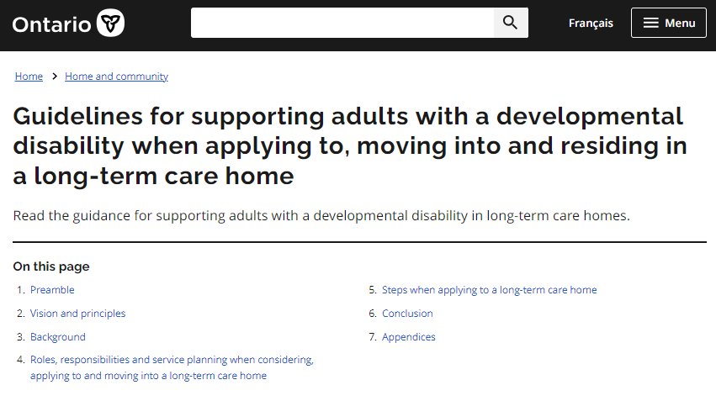
Guidelines for supporting adults with a developmental disability when applying to, moving into and residing in a long-term care home
https://www.ontario.ca/page/guidelines-supporting-adults-developmental-disability-when-applying-moving-and-residing-long-term-care-home
2006, 2017 and updated in 2022 due to legislation changes including bill 7
Protections against inappropriate placement
Challenge – not well known and not well disseminated in either health or developmental services

Slide 9
Advocacy
Nationally – Administrative lead for NTG Canada (National Task Group for Dementia and people with Developmental Disabilities)
Co-leading NTG Canada Consortium with Dr. Nancy Jokinen and Leslie Udell
National Dementia Curriculum
National Dementia Strategy
Provincial Network (Developmental Services) Health Working Group
Health Services Improvements – Primary Care Project, ALC, Home and Community Care, IPAC, Data

Slide 10
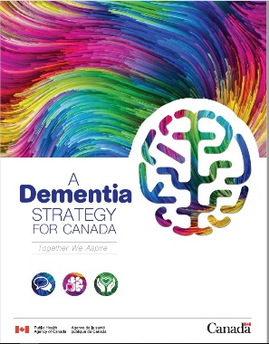
Advocacy: A Dementia Strategy for Canada
“A Dementia Strategy for Canada: Together We Aspire”(2019)
Recognition of equitable access barriers & increased risk of dementia for adults with ID.
Notes:
SANDY
People with Down syndrome have an increased risk of Alzheimer disease as compared to other adults with intellectual disabilities and the general population. By the age of 65+, research has shown an 85% risk for this group. Research around the risk of dementia for people with I.D. without Down syndrome finds they have at least the same degree of risk as the general population or perhaps an increased risk. Research and anecdotal information highlights that adults with I.D. have poorer access to good quality healthcare and encounter significant challenges in getting a diagnosis of dementia.

Slide 11
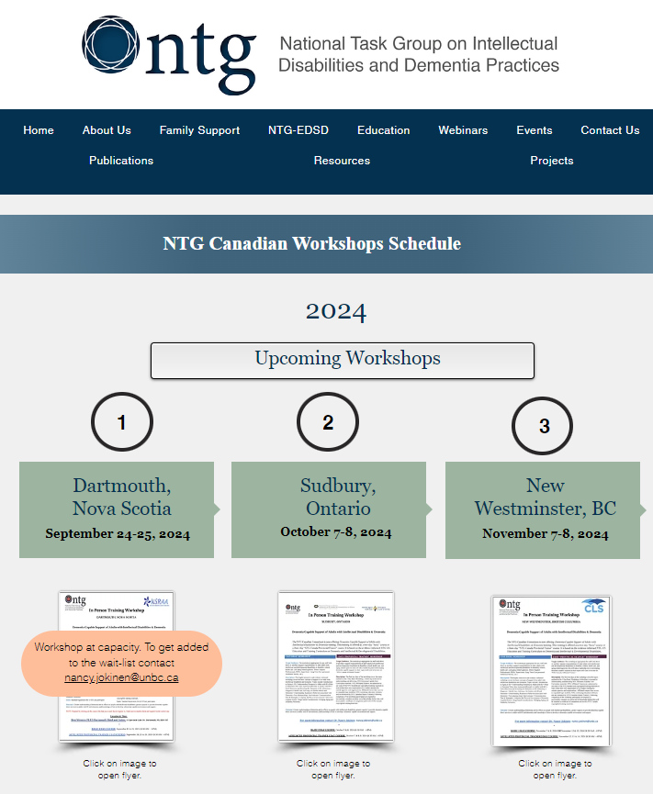
NTG Canada
Supporting the education and training across Canada on the program - Dementia Capable Supports of Adults with Intellectual Disabilities and Dementia Curriculum, see https://www.the-ntg.org/workshop-schedule-canada for more details
2 day basic workshop
3 day affiliated trainer workshop
Leveraging the affiliated trainers to help disseminate information, encourage them to utilize, and educate about the dementia guidance and new resources
Curriculum revised and updated related to the new guidance

Slide 12
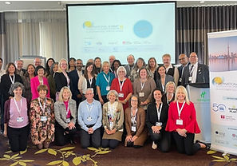
2nd International Summit on
Developmental Disabilities and Dementia
October 2023 in Toronto
Previous Summit – Glasgow 2016
Reena as part of it's 50th Anniversary in partnership with NTG Canada hosted an International Summit on ID and Dementia in Toronto - https://www.the-ntg.org/copy-of-glasgow-summit-on-id and the outputs are here - https://www.the-ntg.org/summit-secretariat
Limited to International experts with extensive speciality in this area – roundtable, working meeting
Three significant issues - human rights and intellectual disability, co-incident neuroatypical conditions, and brain health and wellness practices

Slide 13
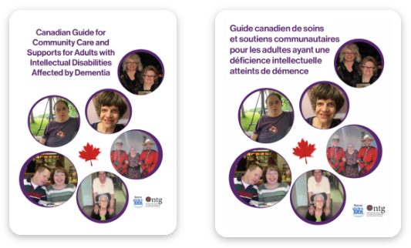
NTG Canada
After the National Dementia Strategy was announced – grants and opportunities to do the work mentioned in the strategy
National grant from Public Health Agency of Canada (PHAC) to adapt and update guidance for Canadians on dementia support for individuals with developmental disabilities
Developed resources from these guidelines for individuals with developmental disabilities, families and staff (both developmental services and seniors/health)
All resources can be found at https://reena.org/initiatives/dementia-strategy-project/ or https://www.the-ntg.org/canadian-consortium-news

Slide 14
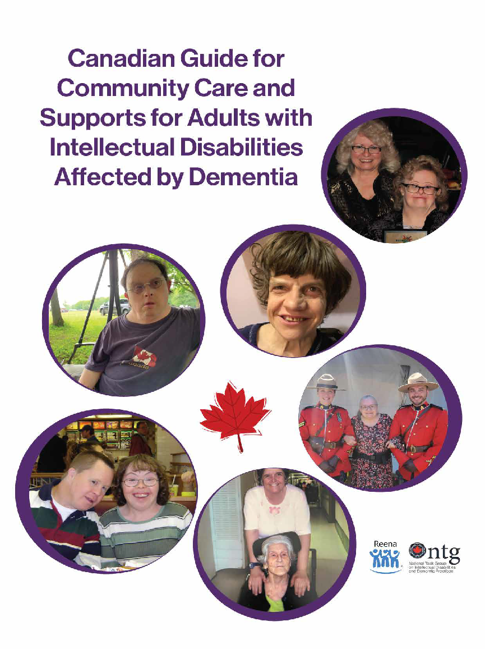
Project Background
Project funded by Public Health Agency of Canada – Dementia Strategy Fund.
Reena in collaboration with the National Task Group-Canadian Consortium (NTG-Canada).
Updated the 2013 NTG Community Guidelines. The new guide and resources was released in 2024.
Project Team: Dr. Nancy Jokinen, Leslie Udell, Sandy Stemp, & Tracey Berman
Notes:
SANDY

Slide 15
Why the Guide is Important
Raises awareness
Education/information for:
For individuals with intellectual disabilities
Families
Staff
Organizations
Encourages early detection screening NTG-Early Detection Screen for Dementia (NTG-EDSD)
Supports planning (organization, family, & personal)
Promotes quality of life
Community focused
Notes:
SANDY

Slide 16
Overview of Guide Sections
Background | On the initiative, underlying principles, dementia as it affects people with ID
Staging Model | Early recognition through to late / end stage Non-pharmacological approaches Expected changes and suggested supports
Early Detection | Use of an early detection tool (NTG-EDSD) Pre and post diagnosis use.
Program/Support Options | Critical concerns in varying circumstances Living with family, alone, with others Day service
Emerging Issues | Brain health/Risk Reduction, Cross-sector Collaboration, Grief & Loss, Indigenous Peoples
Notes:
SANDY

Slide 17
Project Resources
Designed for:
Adults with intellectual disabilities
Families
Staff
Notes:
SANDY

Slide 18
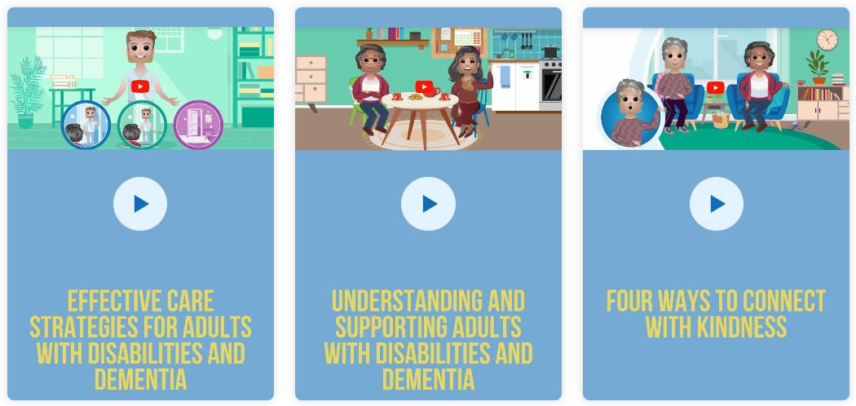
Project Resources – Instructional Videos
Notes:
SANDY

Slide 19
More Project Resources – Actions and Ideas to Help with Dementia
Notes:
SANDY

Slide 20
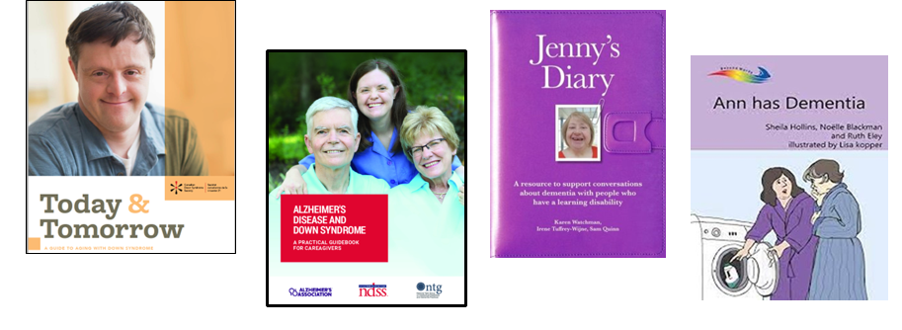
Additional Resources Identified in the Guide
The Guide has an extensive reference list and makes mention of several external resources including:
Notes:
SANDY

Slide 21
The NTG-EDSD – Recommended in the 2024 Guide
The NTG-EDSD is a means of documenting a person’s functional abilities and health over time.
Completed by family or staff familiar with the person.
One way to document a baseline.
Documented changes discussed with a health care professional.
Possible early referral for assessment.
Potentially leads to appropriate, timely treatment to alleviate a condition causing change.
Engages the person, family and staff in planning.
Notes:
SANDY

Slide 22
The NTG-EDSD – 4 Key Sections
Demographics
Ratings of health, mental health and life stressors
Review of multiple domains including: Activities of Daily Living Language and Communication Sleep – Wake Patterns Ambulation Memory Behaviour and Affect
Chronic Health Conditions
Notes:
SANDY

Slide 23
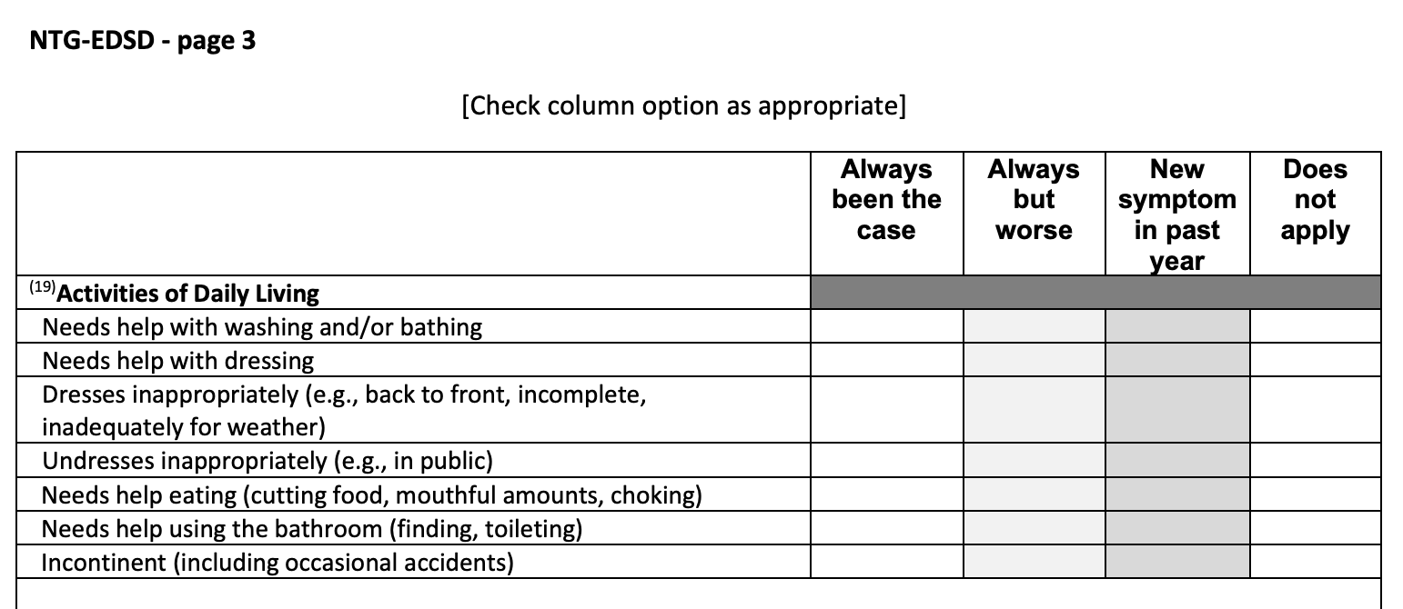
The NTG-EDSD – Completing the Tool
Notes:
SANDY

Slide 24
The NTG-EDSD – Why is this Information Needed?
Helps with the visit to the physician and or for an assessment by a clinician.
Basic information about the adult in one place.
Focuses on behaviors that are usually associated with cognitive decline and or functional changes.
Looks at other diseases or conditions that may be present and impact the adult’s functioning.
Notes:
SANDY

Slide 25
All Older Adults’ Needs Include:
Good coordinated health care
To address age-related changes that may be expected as well as the risks for onset of chronic conditions.
Adaptations to both the social & physical environments
To be age-friendly.
Planning for future needs
Practical and emotional supports, residential.
Healthy aging strategies
Prevention (e.g., screening, activity/exercise, diet)
Health care (coordinated, knowledgeable about aging & disability).
Notes:
SANDY

Slide 26
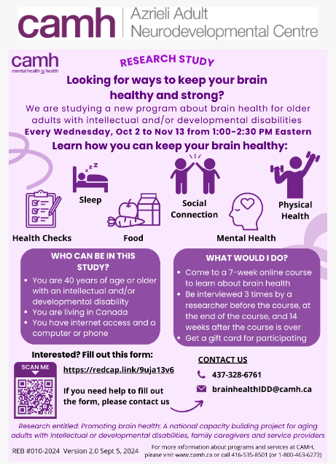
Other Research – Brain Health
CIHR National grant on brain health – Dr. Yona Lunsky's research team
Azreili Foundation partnership
Important to include people with developmental disabilities
Virtual sessions for individuals with developmental disabilities, families and staff
4 sessions in total
Topics include - Physical Health, Mental Health, Strategies to reduce dementia risks, Dementia screening and assessment tools

Slide 27
Other Research – Dementia Screening
Yona Lunsky's research team with CIHR funding
Evaluating implementation of a dementia screening program for people with intellectual and/or developmental disabilities in community agencies across Canada: Facilitators, barriers and next steps for spread and scale
Focus on NTG-EDSD and how it is being utilized in agencies, what is working, what are challenges and how to improve
Reena is one of three agencies in Ontario participating
9 agencies over 4 provinces
Case study approach
Over 3 years

