Slide 1
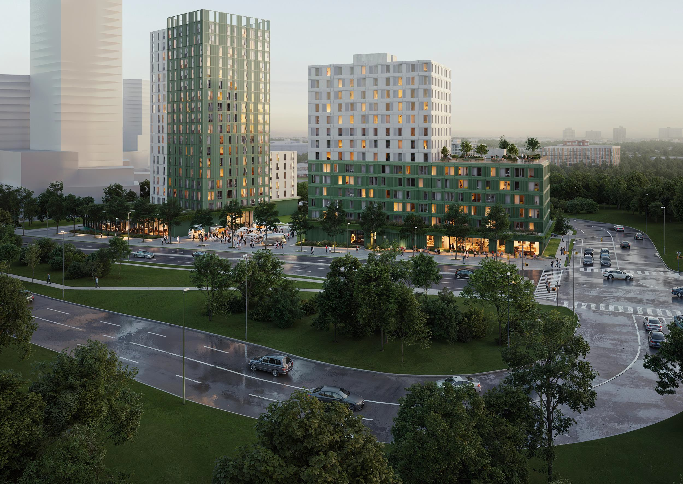

ARBO Lands Update
Project Overview:
Reena-led affordable housing project in partnership with The Rose Corporation (Development Manager) and Serotiny (Architect/Pre-Construction Manager), Mishkiki Commons at ARBO will bring at least 300 rental units to the Downsview site with two buildings, a high support and a mixed use affordable building.
Application Status: 1 of 20 preapproved applicants. Full application completed May 7th .
Roles: Reena: Applicant, Owner, Borrower,
The Rose Corporation: Development Manager → Owner’s Representative (during construction)
→ Asset Manager (post-occupancy), and Serotiny

Slide 2
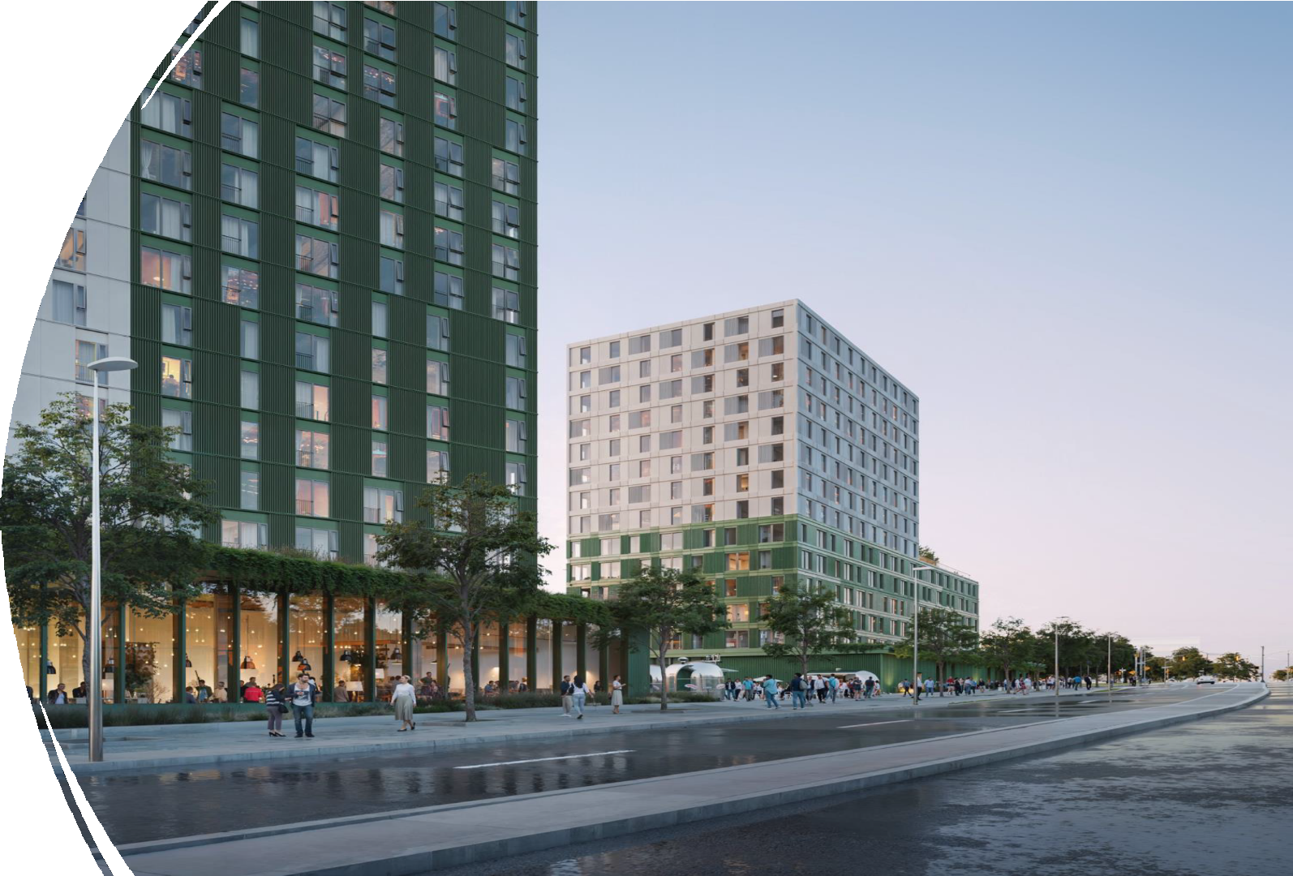
Focus Population:
The development prioritizes individuals
with developmental disabilities, seniors,
and other vulnerable groups. Reena will
own both buildings and coordinate support
services through partner agencies across
both buildings with a focus on 122
supportive housing units.​
Cultural Framing & Naming:
“Mishkiki” (Anishinaabemowin for
medicine) reflects Indigenous healing and
community values - symbolized by the
“Commons” concept.
Financial costs and benefits:
The project may require up to $4 million in
fundraising to access the over $200 million
in eligible loans and contributions. Reena
would add over $160 million book value to
assets and generate an annual income
stream.

